Slide 1
Making Youth Mental Health Information More Accessible for All
INFM 600 Final Project
Cooper, Christine, Devanshi, Marie-Helene, Melody, Zack

Slide 2

Background
Mental health in children and adolescents (0-18 years old) is often overlooked and not taken as seriously as physical health conditions
Mental health conditions account for more costs than diabetes, cancer, and respiratory disorders combined
Prince George’s County has a source with mental health providers for all age groups that must be manually combed through for information
Time consuming, cumbersome
Specific need for source for children and adolescents
https://www.healthaffairs.org/do/10.1377/hblog20151001.050925/full/

Slide 3
Why is this service needed?
Reviewed published materials and found that such a service does not exist currently and services that exist are not evidence-based and population-specific
Adequate social and emotional support severely lacking in Prince George’s County
Relative to the rest of Maryland
Need for easy-to-access information by parents, family members, clinicians
Our information service provides this information in an easy to understand, accessible manner
Services that do currently exist are not well-informed
“Many mental health apps are not evidence-based, particularly for the pediatric population. Moreover, some apps may not only be ineffective, but also harmful, with many sharing health data with third parties.”
Our service would rely on information gathered in an evidence-based way with a pediatric population in mind
(http://www.pgchealthzone.org/, https://permanent.fdlp.gov/lps120599/KEN02-0129.pdf, https://www-sciencedirect-com.proxy-um.researchport.umd.edu/science/article/pii/S0890856721006705)
Notes:
Add literature review here.

Slide 4

Team 1’s Innovative Solution
Website and web-app that provide information on mental health providers and services for children and adolescents
Fun, engaging, educational, & easy-to-navigate site
Has information on mental health providers, resource guide, common condition search features, etc.
Made for teens, their families/caregivers, clinicians
Includes an interactive visualization of resources

Slide 5
Project Overview
This website and web-app service enable users to find relevant information that they need. Integrated into the web-app and website is an interactive map. Other Tableau dashboards are provided separately that provide further information and analytics for users. The dashboards and interactive map can also function on their own and are easy-to-use. They are designed for use by users with all levels of technological backgrounds to help find services and necessary information for mental health needs. A user could examine the data to answer the questions, “Where is the closest crisis center near me?” and “Who do I call if I am feeling suicidal?” Online accessibility would be the best way to put this service into use because most people have access to the internet and any person with internet access has access to this tool.

Slide 6
Vision and Objectives
Goal is for families, parents, caregivers, clinicians, and children and adolescents using this tool to find resources, answers, and other needed information to help themselves and their families and clients with youth mental health needs
Objective is to make this search easy to navigate and use for all parties involved regardless of technological background
While this tool currently focuses on PG County, MD, our vision is for this service to be expanded throughout the United States
Our service can be used independently of insurance companies or mental health agencies
Not-for-profit service
Notes:
Our vision and objectives for this service provider is to give families parents, caregiver

Slide 7

Data Source
Notes:
We have Ask PG County for updated information, 4x/year to update service

Slide 8
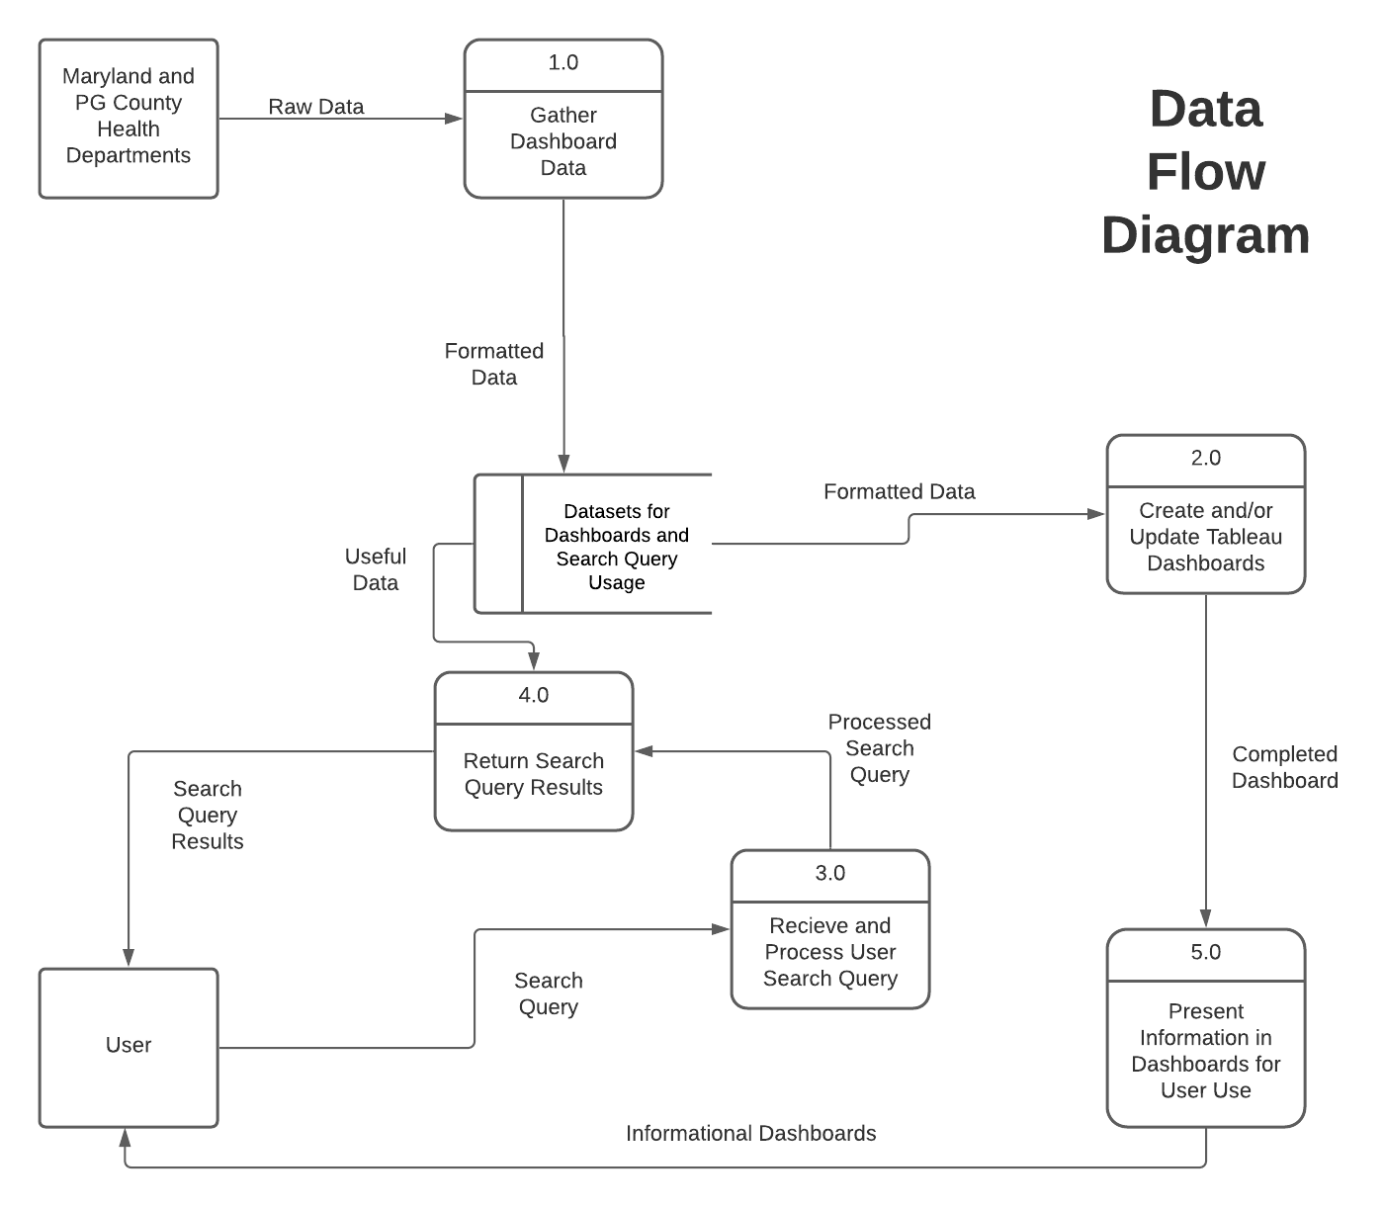
Data Flow Diagram

Slide 9
ERD
Service Provider
Service Provider_name
Service Provider_Phone number
Service Provider_Services
Service Provider_Address
Service Provider_insurance information
User
User_Log ID
User_Last date accessed

Slide 10
Mock Cases

Slide 11
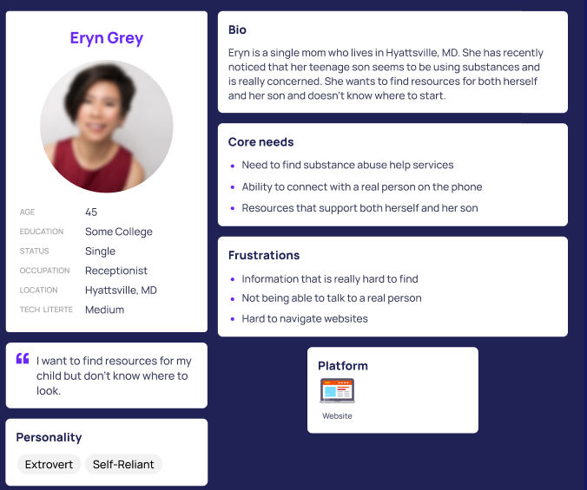
Information that the user wanted:
Substance abuse help services
What to do next to help her son
How to address her child
Information collected from the user:
No information will be collected from her
Notes:
Interface is made with different types of users and their unique needs in mind. Go over use cases.

Slide 12
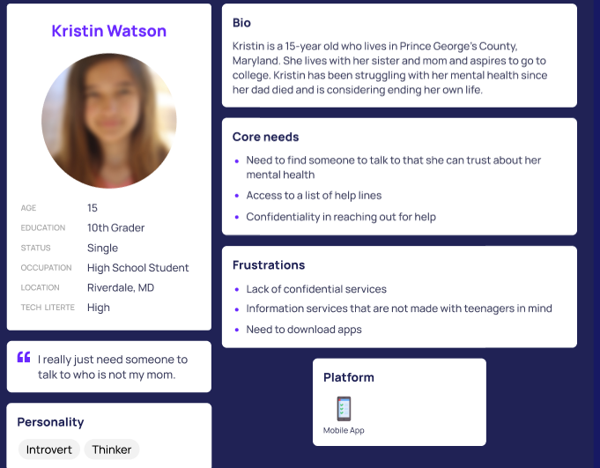
Information that the user wanted:
List of helplines
Mental health resources
Information collected from the user:
No information will be collected from her

Slide 13
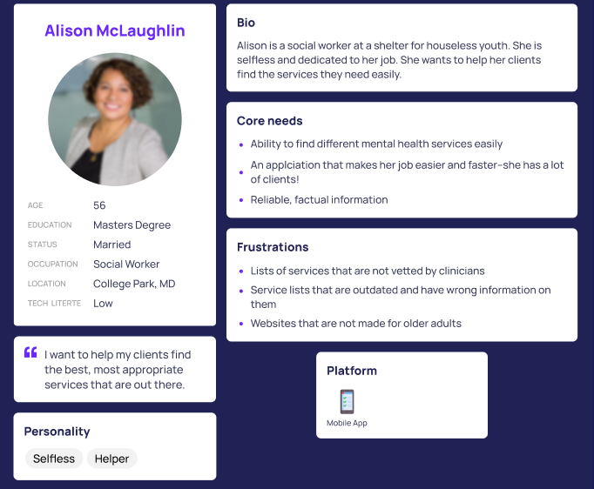
Information that the user wanted:
Mental health resources
Reliable, factual information
Information collected from the user:
No information will be collected from her

Slide 14
Important Features of Website and Web-App
Ability to search for certain providers based on different criteria like race, languages spoken, and location
Ability to search common mental health conditions and learn more about them and their common treatments
Ability to call 911 or utilize other emergency services within the website or web-app

Slide 15
Important Features of Tableau Dashboards
Ability to visually see where providers are located and what services they provide
Via an interactive map
Multiple ways to access information
Pie chart
Bar graph
Ability to showcase Tableau dashboards on website and app and other government websites
Easy to update information with different datasets
Easy to reuse

Slide 16
Interface
Notes:
Show Wireframes

Slide 17
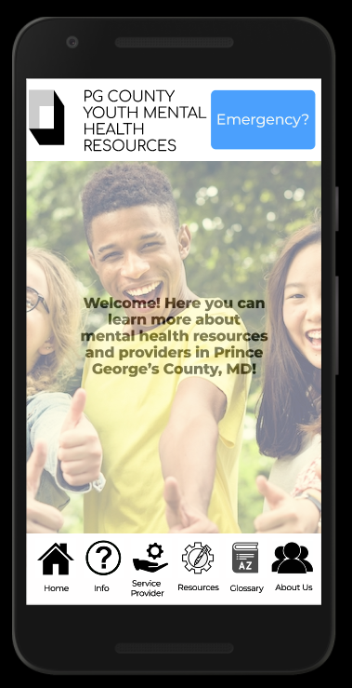
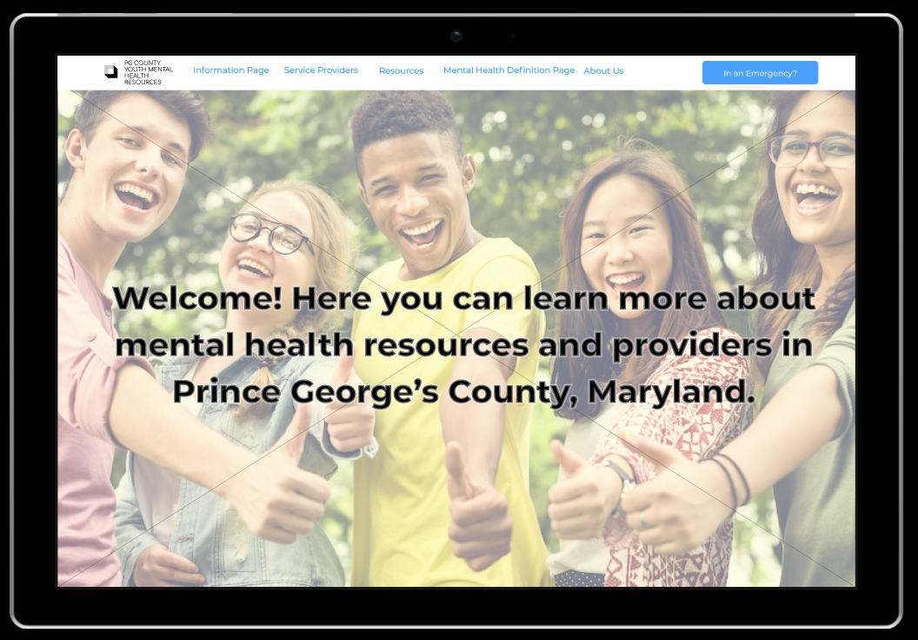

Slide 18
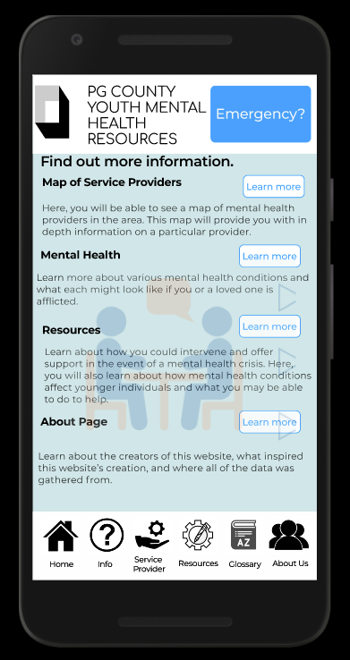
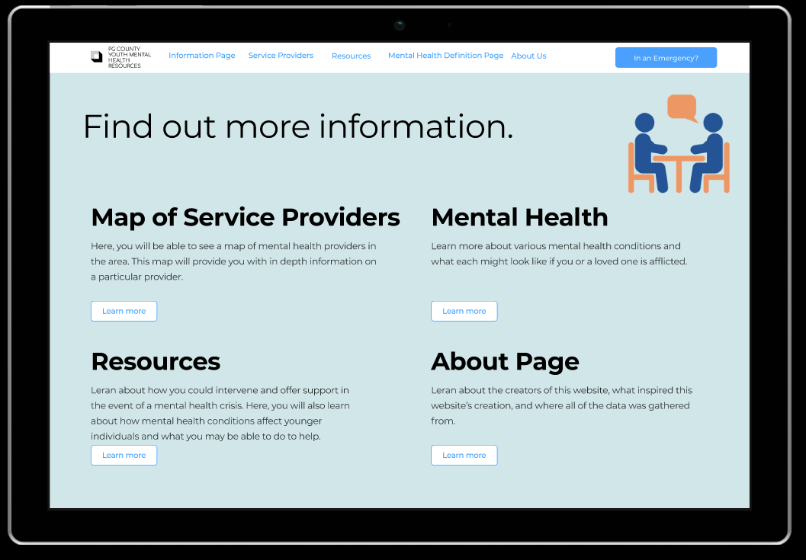

Slide 19
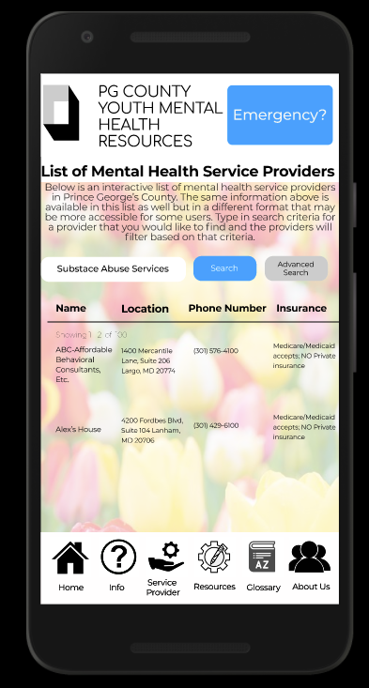
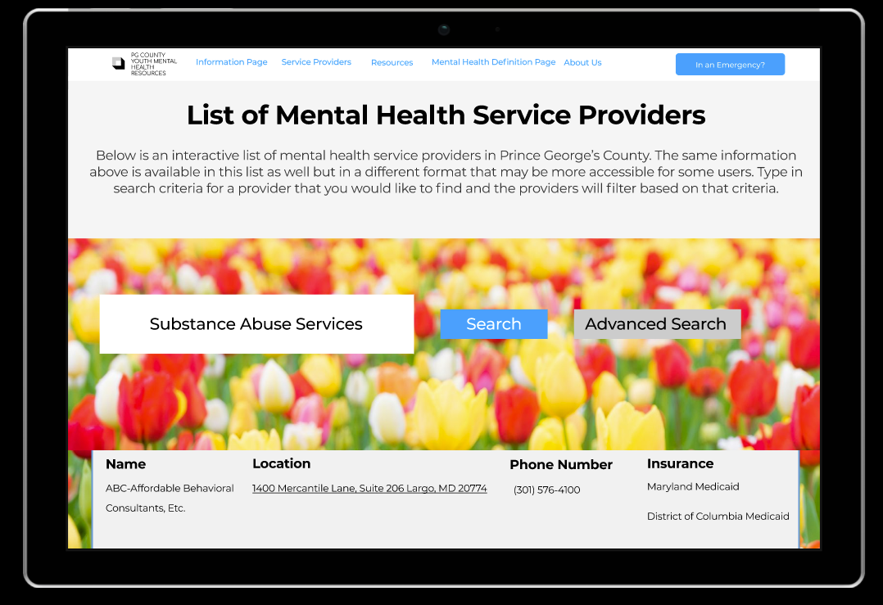

Slide 20
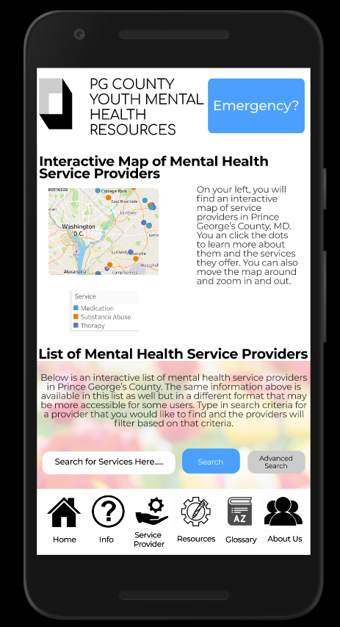
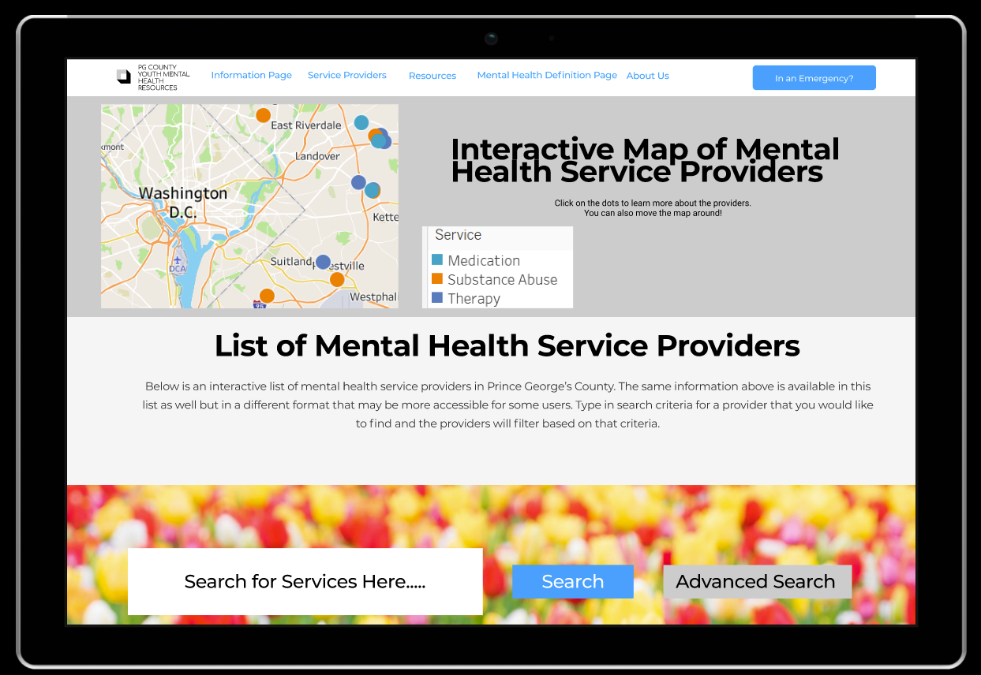
Notes:
UPDATE

Slide 21
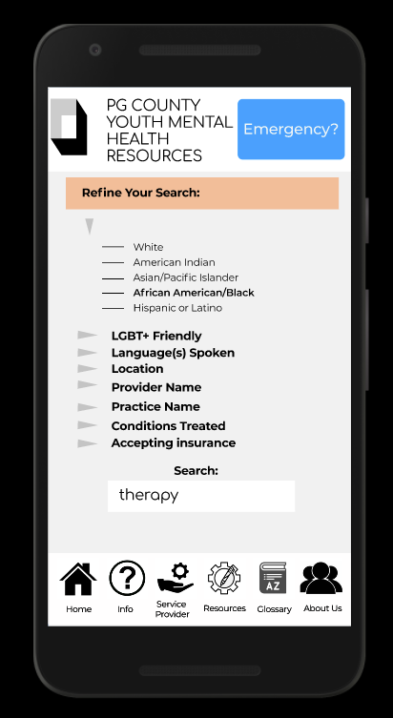
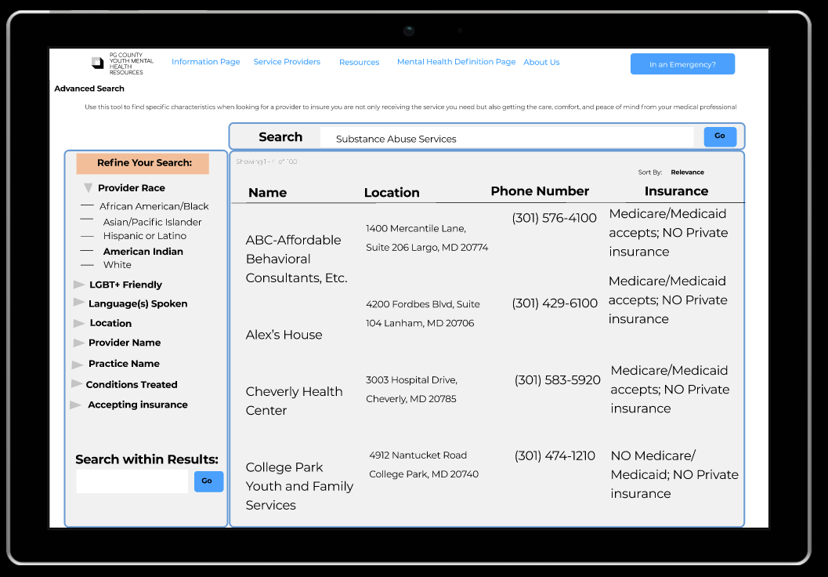
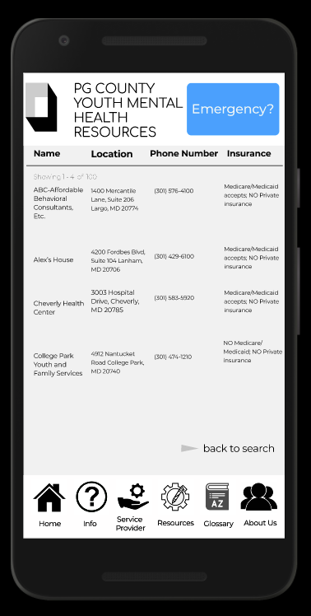

Slide 22
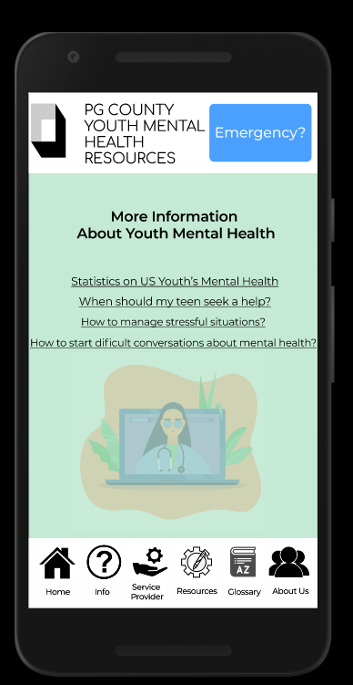
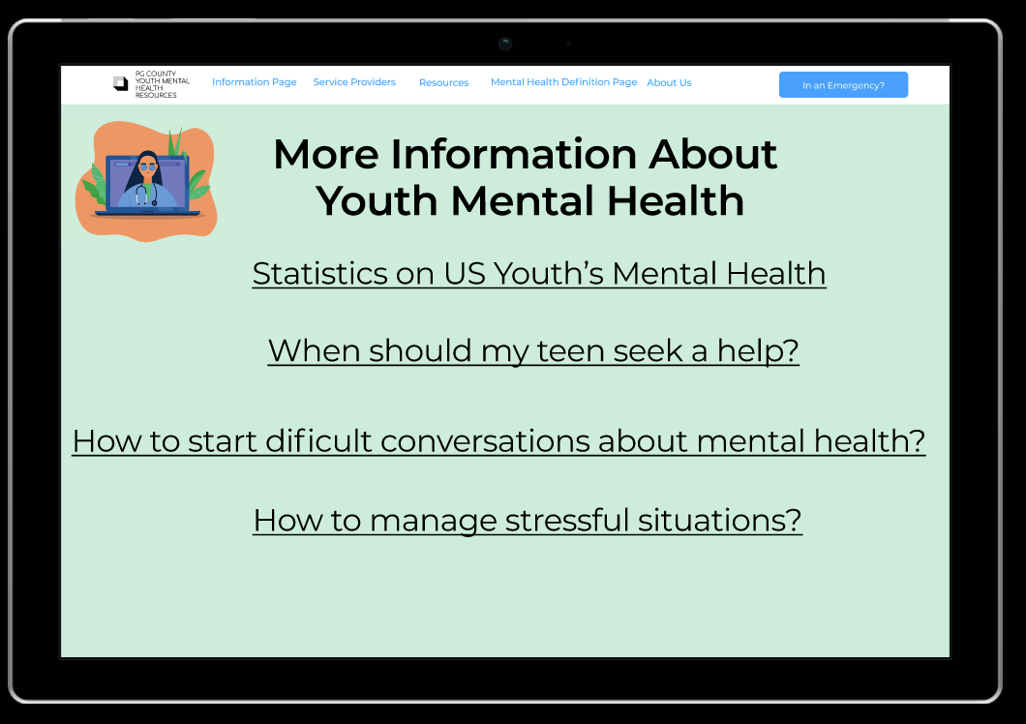

Slide 23
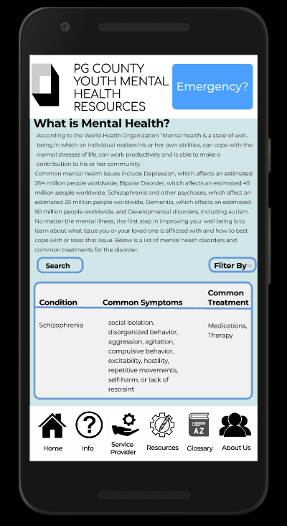
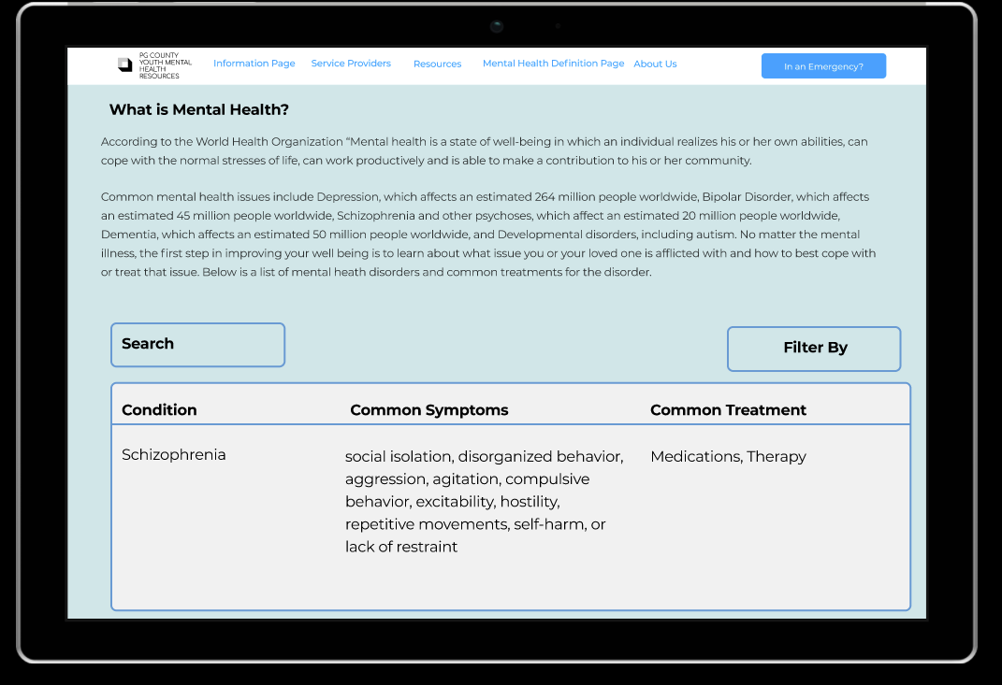

Slide 24
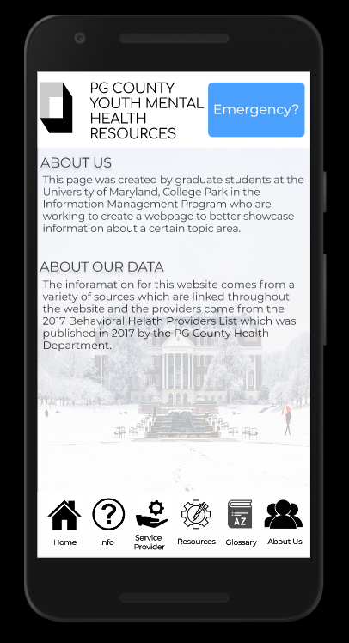
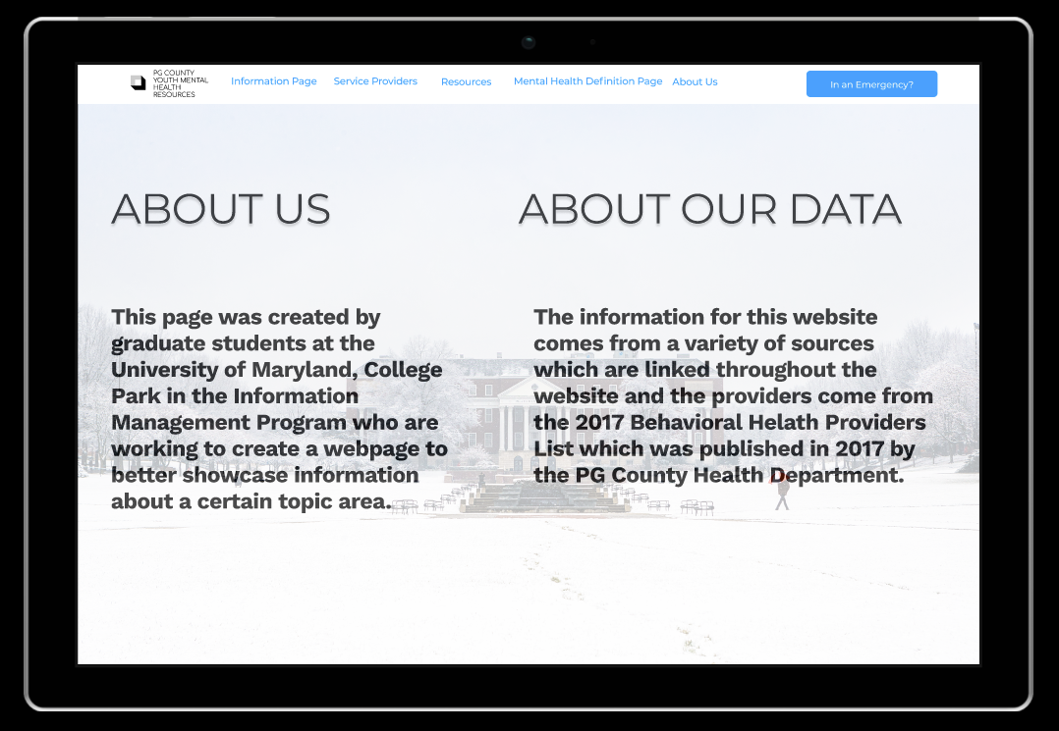

Slide 25
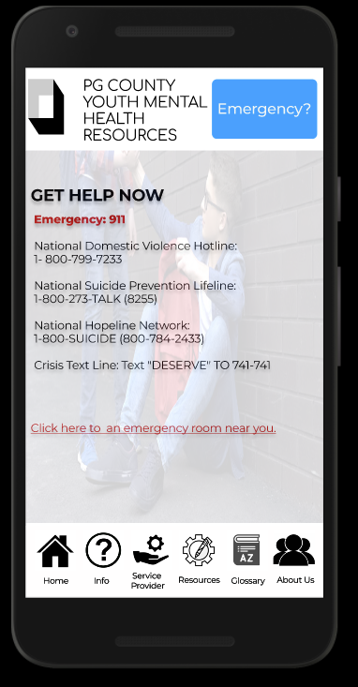
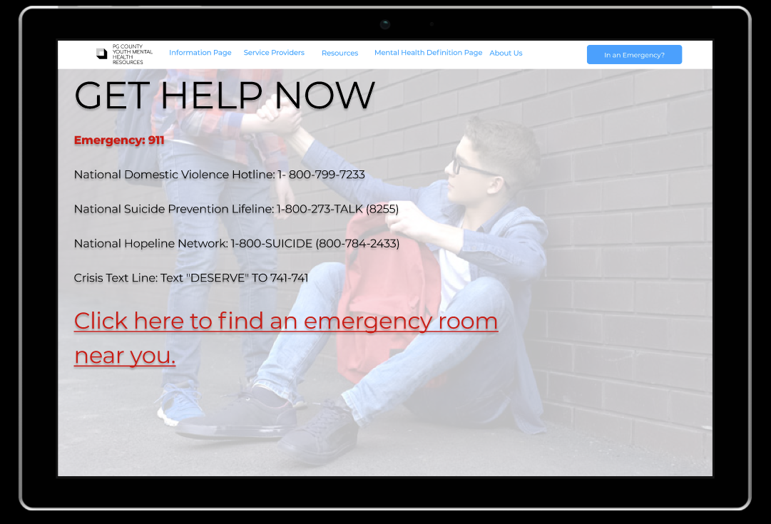

Slide 26
Service Demo

Slide 27
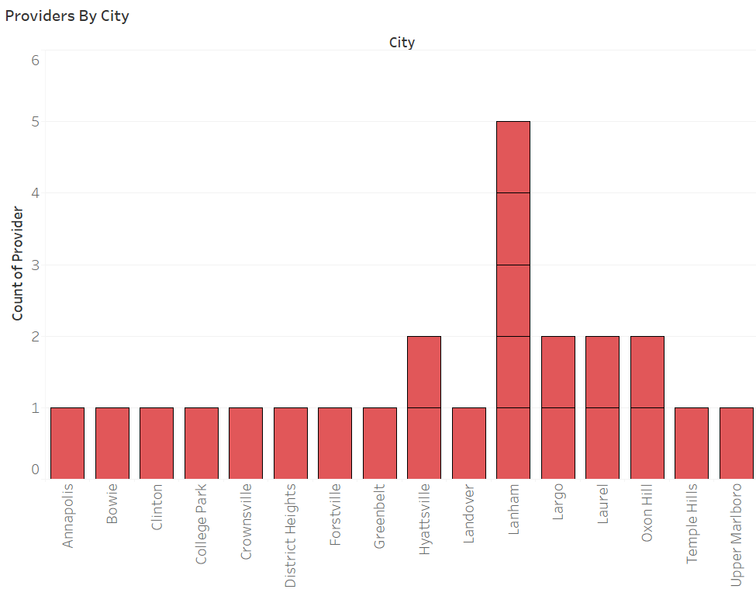

Slide 28
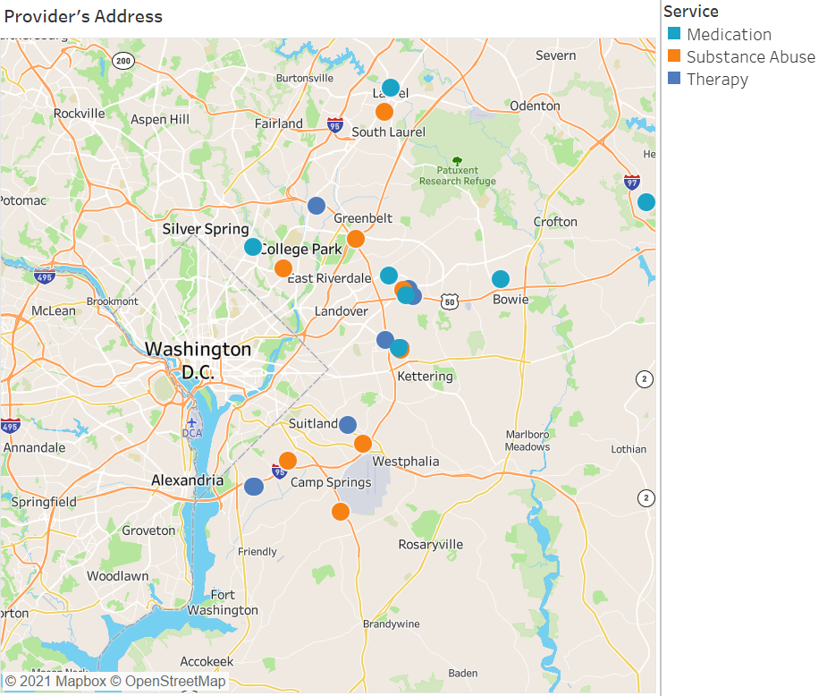

Slide 29
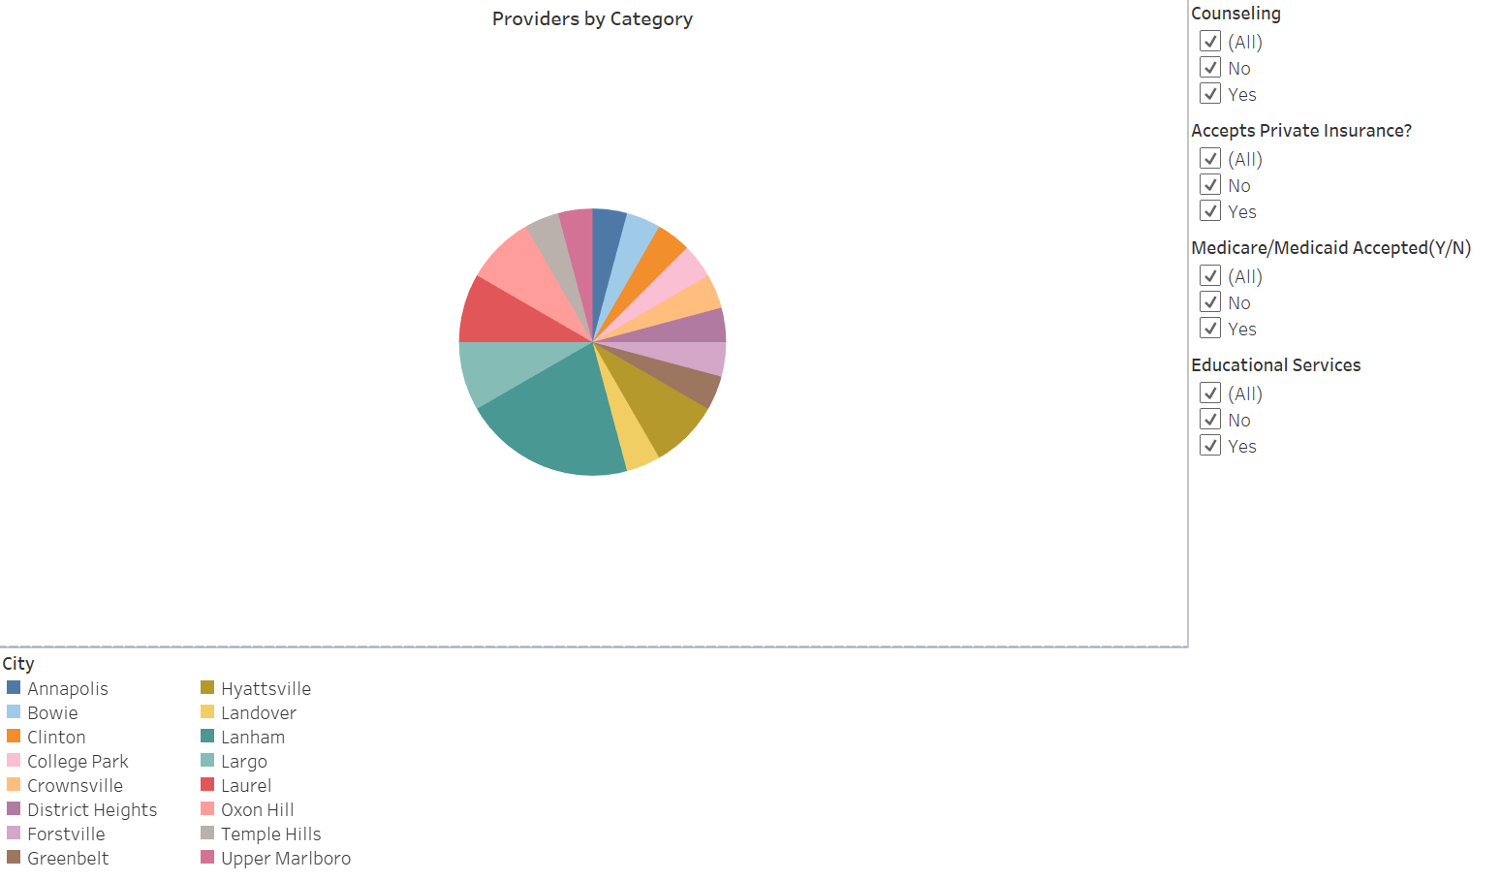

Slide 30
Conclusion
Learned that lack of information provider can endanger vulnerable populations
Learned importance of approaching solution with population
Key to accessibility
Learned that different ways to access and interpret information is critical to understanding
Learned that data is useless if not in an accessible format
Learned how to structure a service with the user in mind using case studies

Slide 31
Questions?

